Slide 1
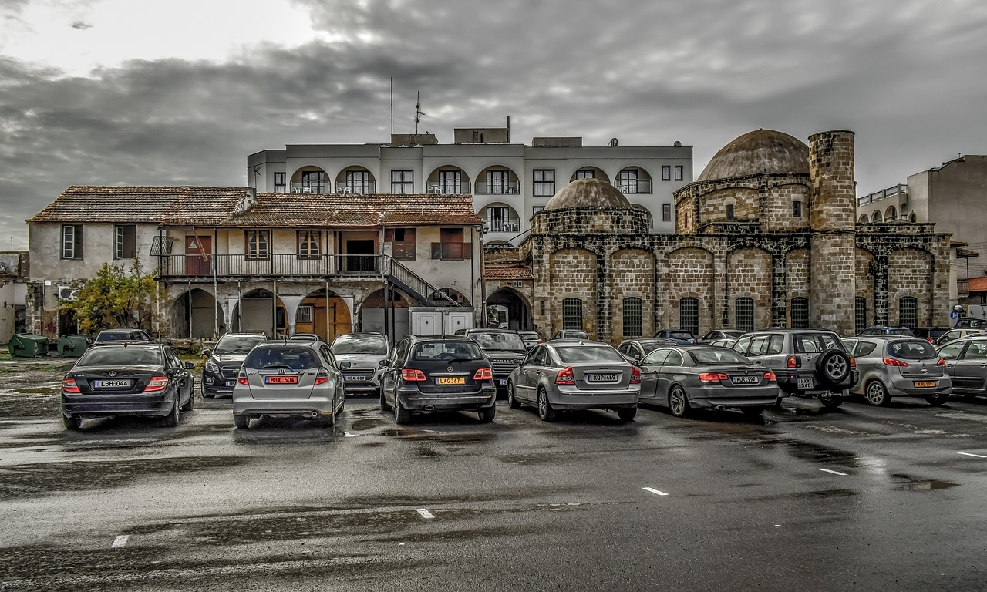
Smart city Parking
Konstantinos Stavropoulos
Hlias Ouzounis

Slide 2

Summary - Problems
34%
Traffic
Time required to park
Traffic cruising
Over 30% of city traffic comes from drivers looking for parking spaces (1)
It takes 8 minutes on average to find a free parking spot.
Impacts
Noise pollution for residents
Pollution from exhaust fumes
Time waste
1. https://transfersmagazine.org/magazine-article/issue-4/how-much-traffic-is-cruising-for-parking/

Slide 3
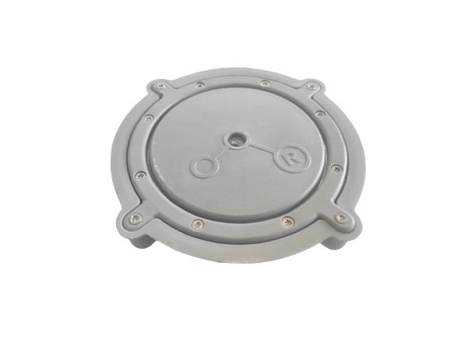
Summary - On street Parking
Goal
How?
Help drivers find a parking spot in the city
Installation of sensors in parking spaces. Informing drivers about available spots and other relevant information
LoRa Parking Sensor S-LG-I3
Detection of parked vehicle
Temperature measurements
Bluetooth sensor
https://market.thingpark.com/lorawan-smart-parking-sensor-cicicom-sl-g-i3.html

Slide 4
Summary – Functional Requirements
Display of available parking spaces
Automatic selection of spaces based on preferences (accessibility for disabled people, shade, distance)
Notification of spots about to become available.
Option to reserve a parking space.
Navigation guidance to the selected spot
Heatmaps and Graphs
Live temperature and sensor voltage.
Heatmap of current temperature
Average city temperature
Parking space usage frequency
Alerts - Ειδοποιήσεις
Low voltage
Overheating
Illegal parking in disabled parking space
Possible double parking

Slide 5
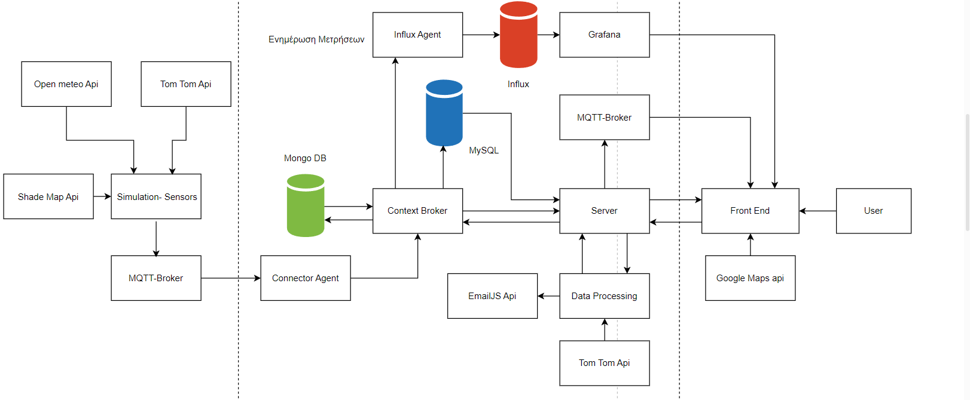
Summary - Architecture

Slide 6

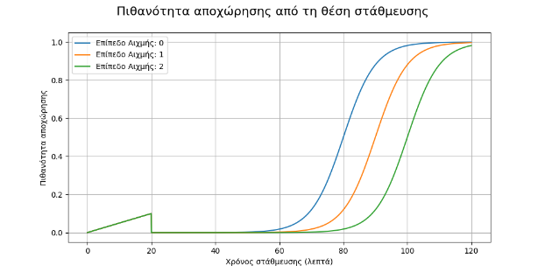
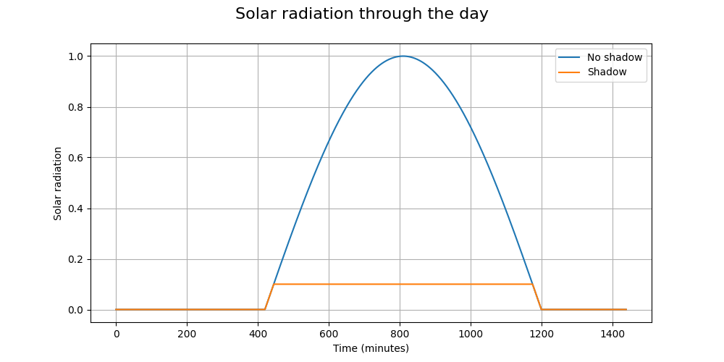
Simulation
Real location of sensors taken from Patras Smart City API
Parking availability
Temperature
Traffic in the area(tom tom API)
How much time the spot is already taken
Distance from “Hot-spots”
Peak level
OpenMeteoAPI (Temperature + Weather)

Slide 7
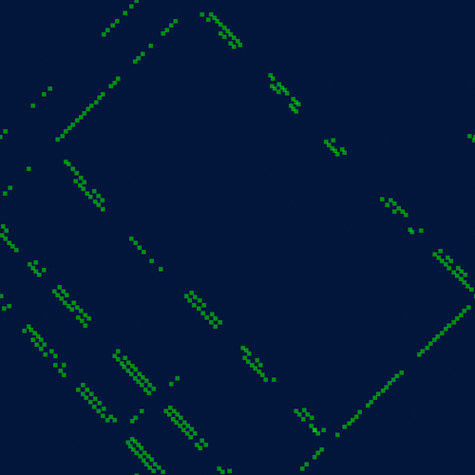

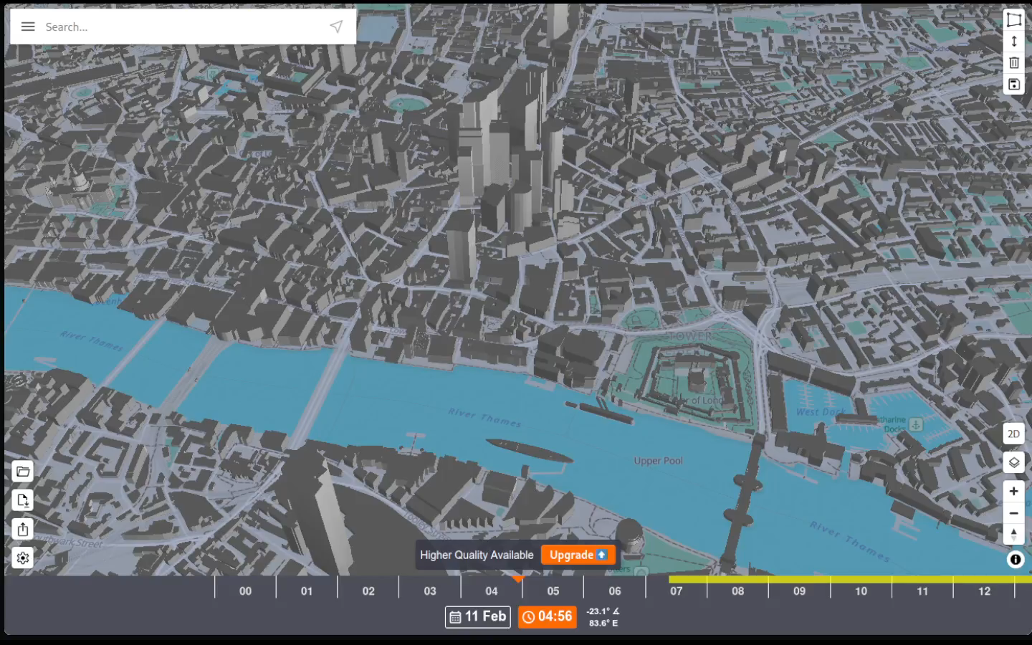
Simulation
Patras
ShadeMap API

Slide 8
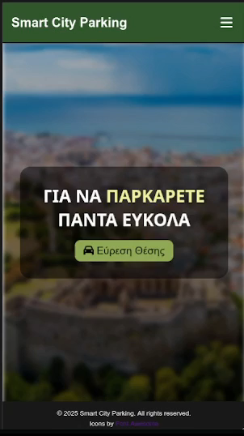
App Demo
Parking Spot Selection

Slide 9
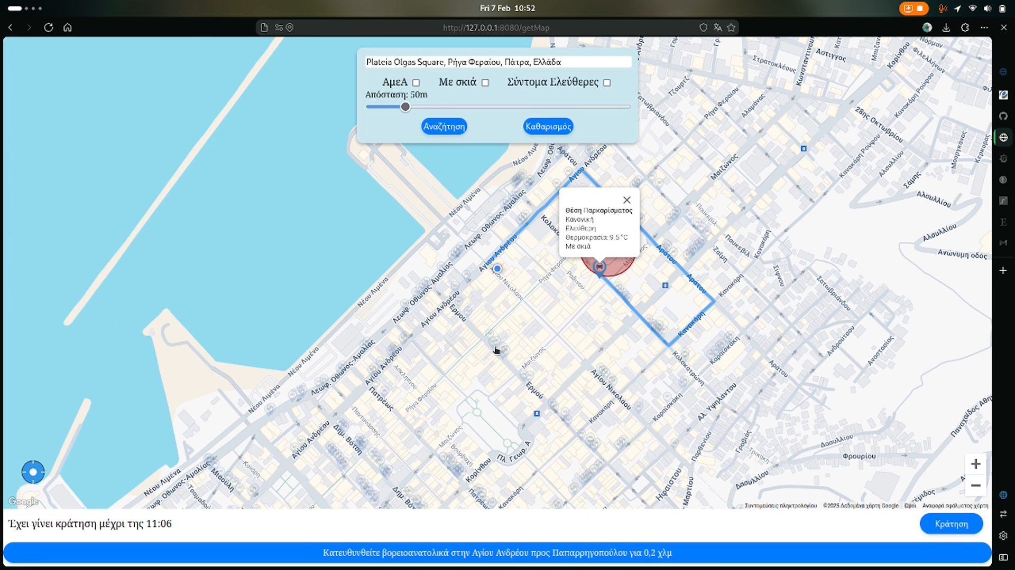
App Demo – Navigation ( old ui)
video

Slide 10
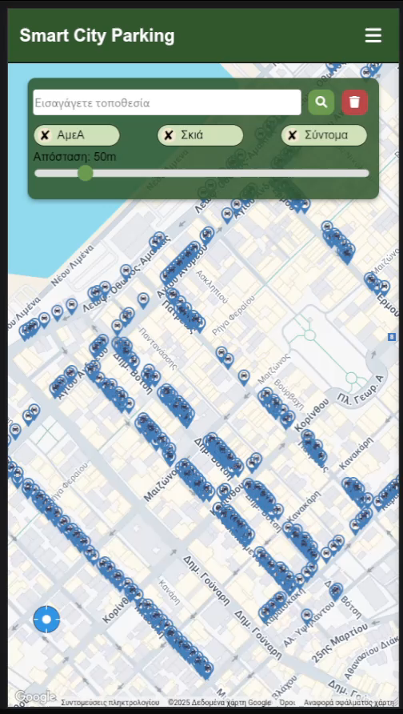
App Demo- Simulation
Real time notifications about available and occupied spots.

Slide 11
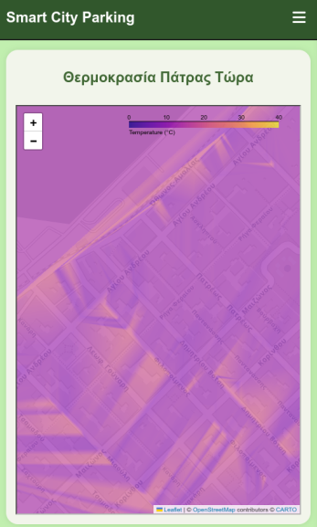
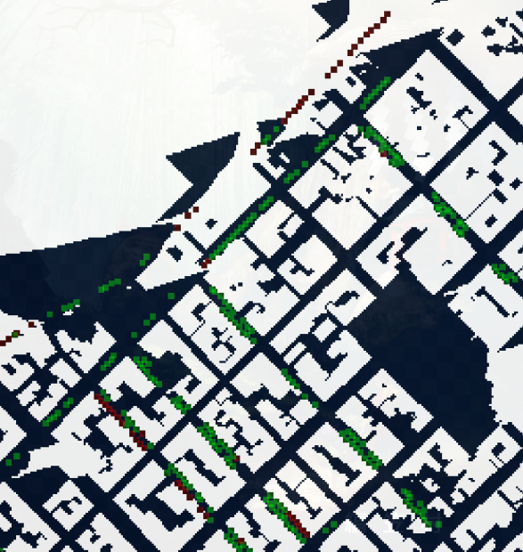
Real shadow data

Slide 12
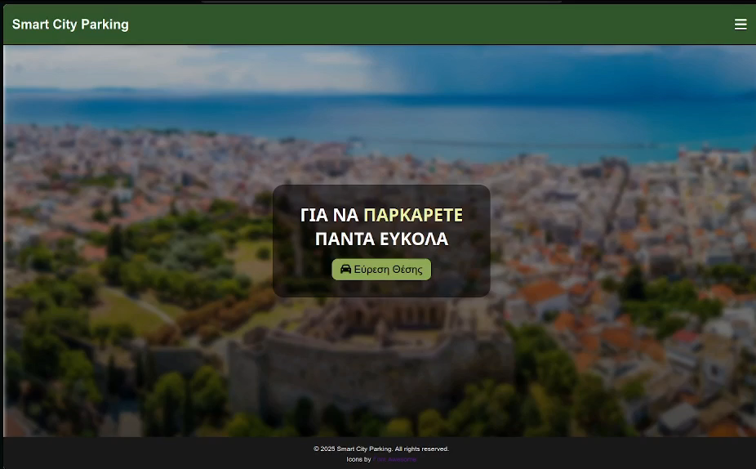
App Demo - Admin Dashboard

Slide 13
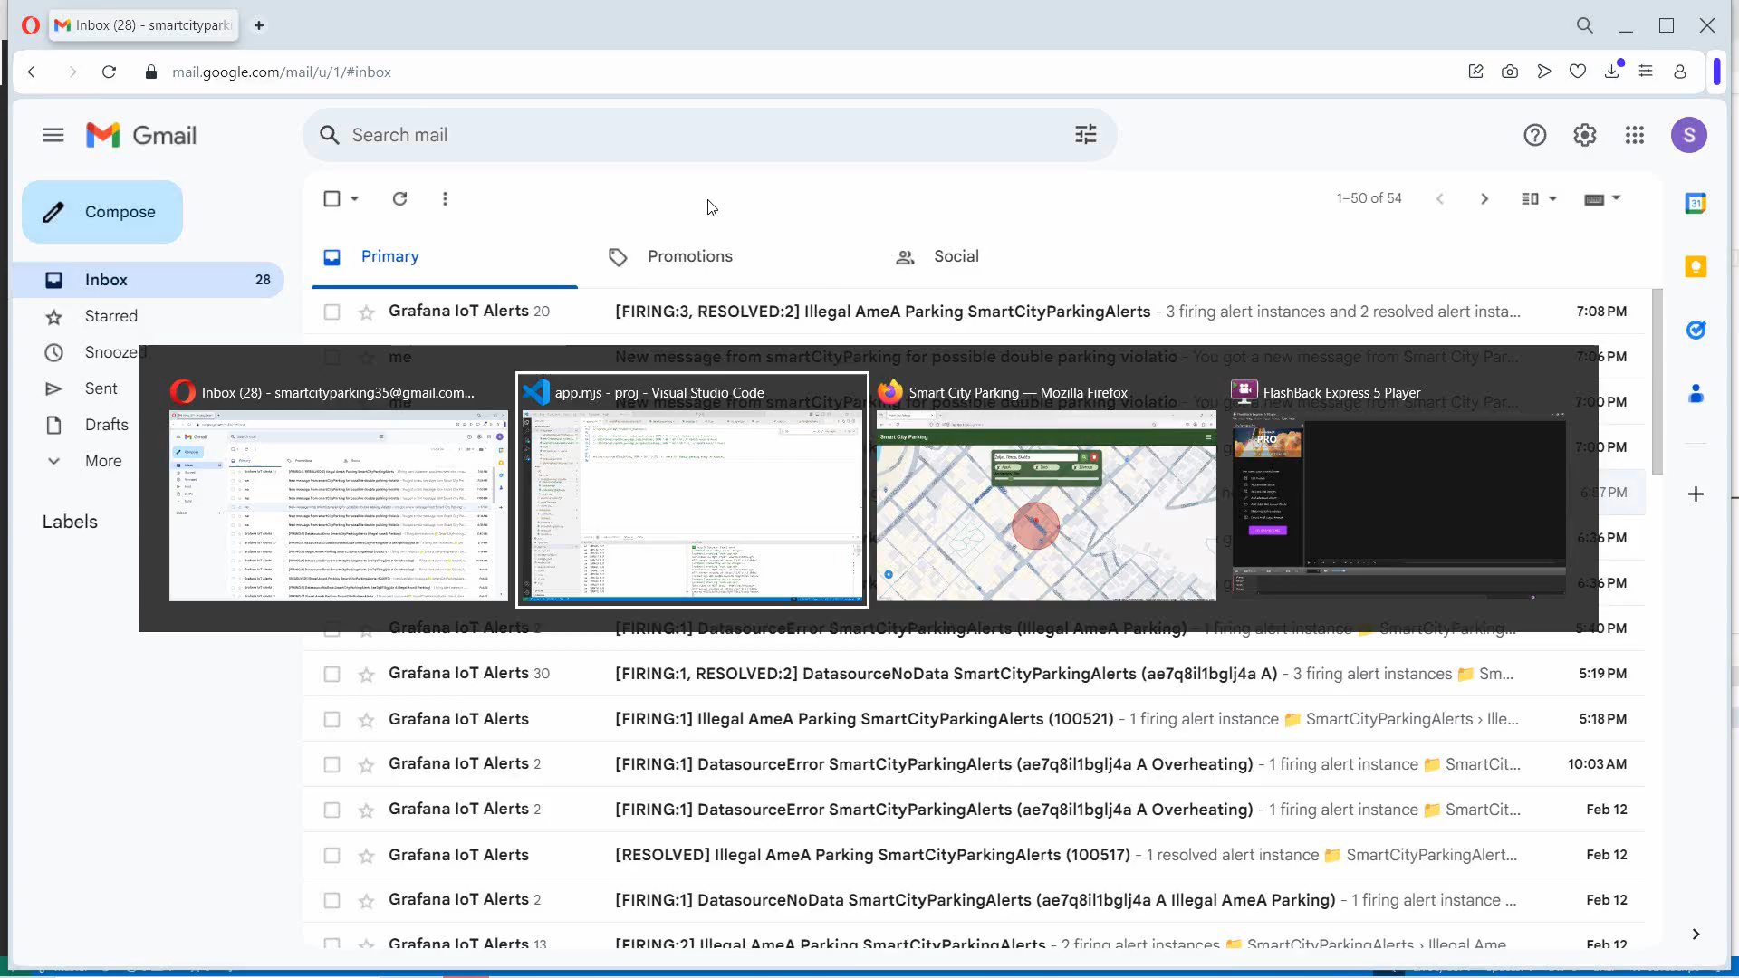
App Demo – Double parking

Slide 14
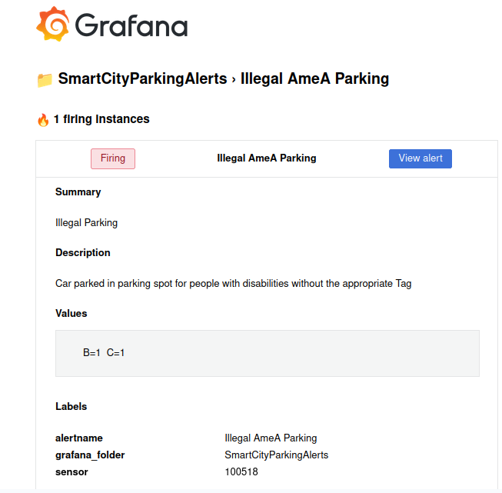
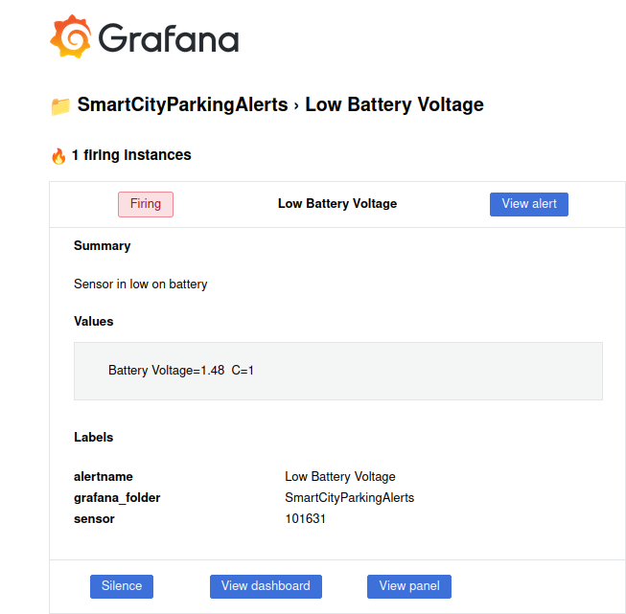
App Demo - Alerts

Slide 15
Time schedule
Hlias
Konstantinos
Both
Competition research
Familiarize with Google-Maps Familiarize with Leaflet
First presentation- Pitch
Architecture implementation
Initial UI
Grafana Alerts
Navigation to parking spots
Reservation ability
Double parking
End of October- Early November
End of November-Early December
Christmas Holidays
Early January
End of January
February
Improved simulation
Heatmaps about live
temperature, average
temperature and
occupancy frequency
of parking spots
Architecture design
Basic Simulation
Basic IoT Agent
Basic Grafana Dashboards
Second presentation
Improved UI
Testing
Third presentation

Slide 16
Questions?

Slide 17
Thanks!
Please keep this slide for attribution

